Slide 1
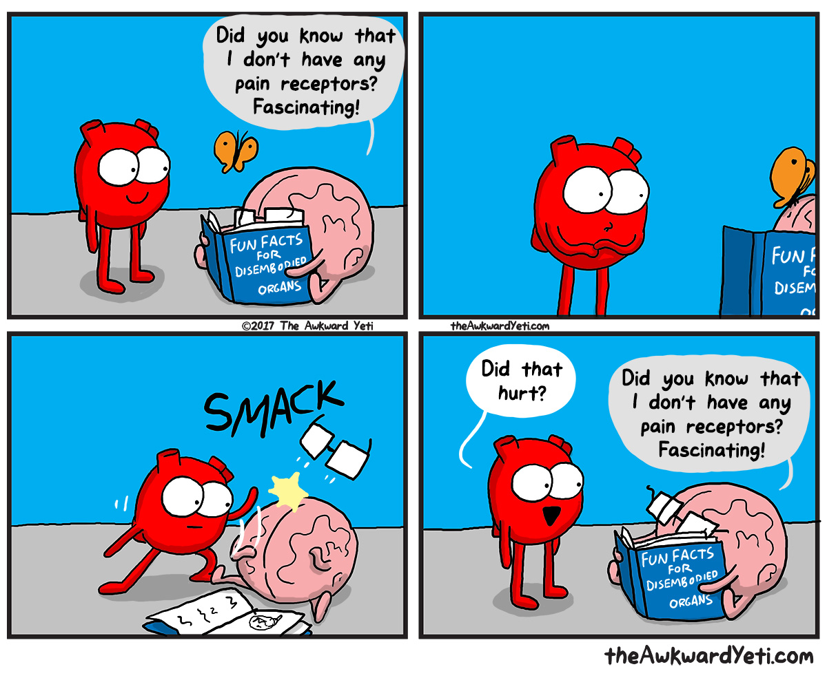
Detecting & Regulating Change

Slide 2
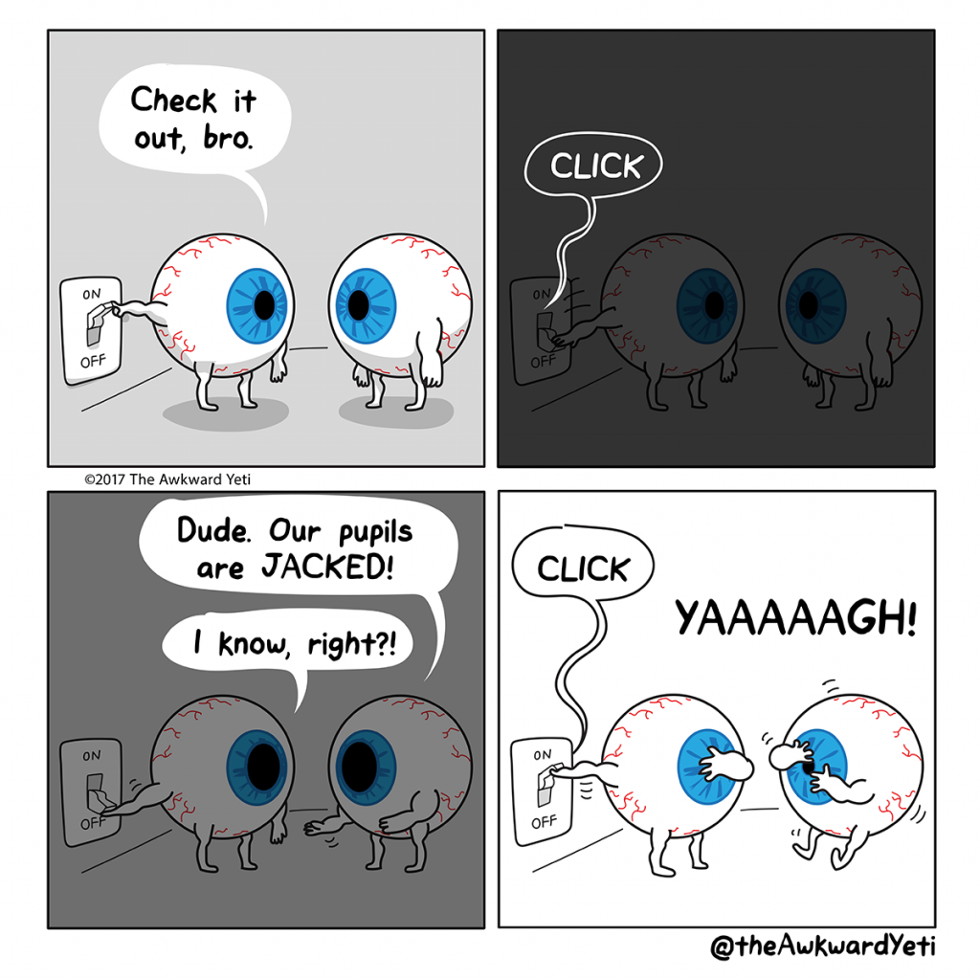
Receptors
Detects change in the body’s internal and external environment
Sense organs
Contain a group of receptor cells of a particular type
E.g. light receptors in the eye

Slide 3
Receptors
Thermoreceptors – detect change in body temperature
Osmoreceptors – detect changes in osmotic pressure
Chemoreceptors – detect changes in concentrations of chemicals (oxygen, carbon dioxide, hydrogen, glucose)
Touch receptors – detect touch/pressure
Pain (nociceptor) receptors – stimulated by damage to tissue

Slide 4
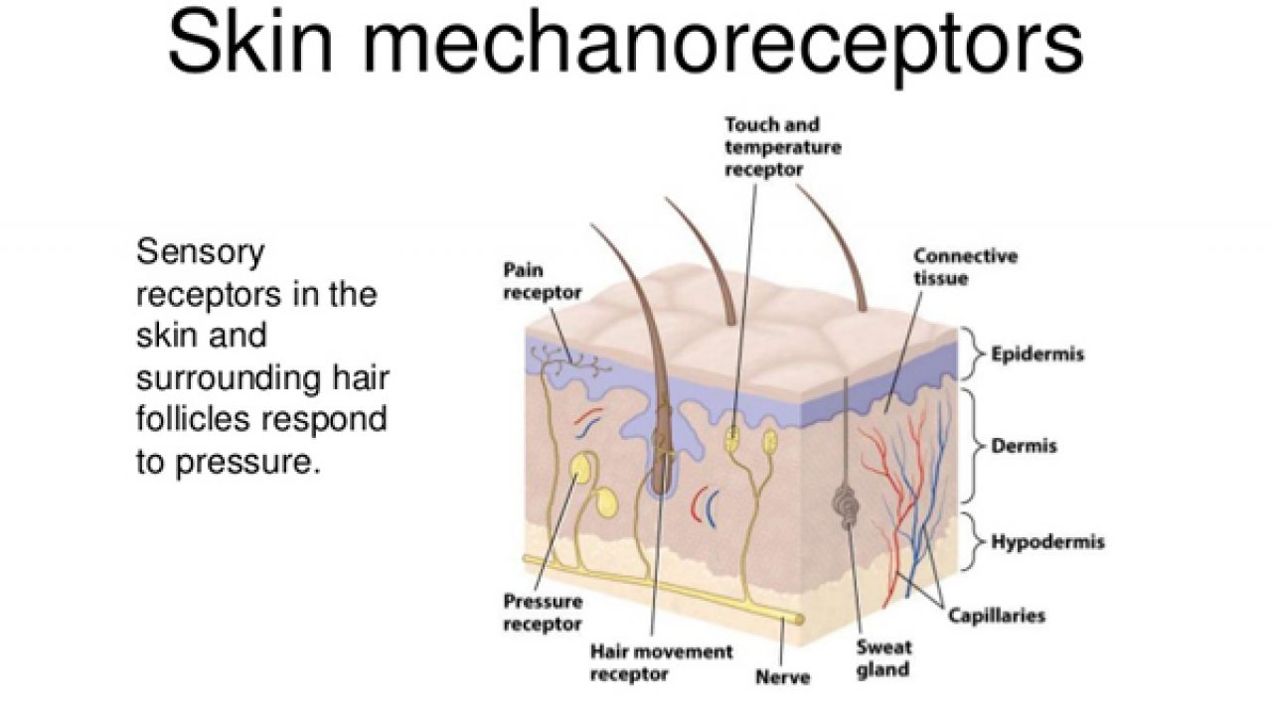

Slide 5
Receptors
TASK Using your text book; in a table summarise each type of receptor, where they are located, and what it is they are stimulated by.
Receptor | Location (are they located in different areas?) | Detects (what stimuli)

Slide 6
What are the four properties of a reflex?
S
I
R
S

Slide 7
Properties of a reflex:
Stimulus is required to trigger – not spontaneous
Involuntary – occurs without conscious thought
Response is rapid – only a small number of neurons involved
Response is stereotyped – impulses travel the same way each time it happens

Slide 8
What is the difference between an innate reflex and an acquired reflex? |Give an example of each.

Slide 9
Learned reflexes
Innate reflexes - complex motor patterns appear during development
Determined genetically
Suckling
Chewing
Following movements with their eyes
Acquired reflexes – through constant repetition
Muscular adjustments required for bike riding
Jamming the brakes of a car
Catching a ball

